Slide 1
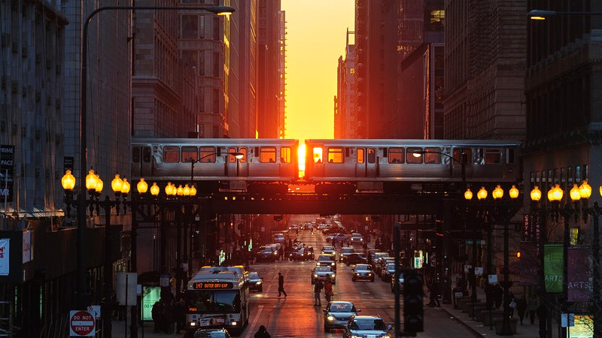
Ch. 12
INEQUALITY
&
REDISTRIBUTION
Lecture Sides
Presented by
Dr. Edward C. Hoy
Notes:
These slides contain content from “Chapter 12: Inequality and Redistribution” and includes supplementary material intended for class discussions and additional real world examples.

Slide 2

INEQUALITY AND REDISTRIBUTION
CHAPTER 12
GOALS
List the determinants of income/wealth in a market economy.
Compare measures of income inequality with other economic measurements.
Provide an overview of philosophical arguments “for” and “against” redistribution.
KENNESAW STATE UNIVERSITY | COLES COLLEGE OF BUSINESS

Slide 3

INEQUALITY AND REDISTRIBUTION
HUMAN WELL-BEING
Depends upon access to G&S:
food,
shelter,
clothing
healthcare
education.
KENNESAW STATE UNIVERSITY | COLES COLLEGE OF BUSINESS

Slide 4
INEQUALITY AND REDISTRIBUTION
Source of Household Income …
Value firms place on the FOP that are owned and sold by households.
2. The willingness and ability of households to consume the output created by firms.
KENNESAW STATE UNIVERSITY | COLES COLLEGE OF BUSINESS
Notes:
In other words, markets provide a mechanism for determining the amount paid to an individual for the employment of their labor and for the use of their land and physical capital.
Income is in related to productivity. But what are those factors that determine an individual’s ability to be productive?

Slide 5
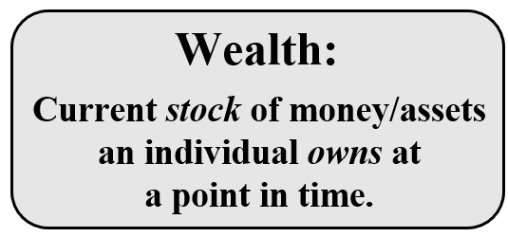
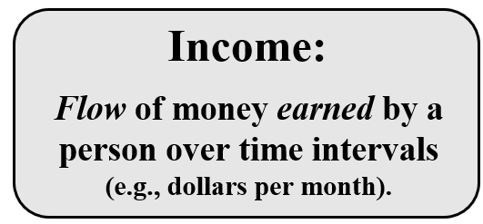
INEQUALITY AND REDISTRIBUTION
HOUSEHOLD CONSUMPTION
(“Access to money”)
“ACCESS TO MONEY” IS DETERMIEND BY …
KENNESAW STATE UNIVERSITY | COLES COLLEGE OF BUSINESS

Slide 6
INEQUALITY AND REDISTRIBUTION
Are the Determinants of a Person’s Wealth & Income the result of …
decisions made by the individual?
(or)
Luck/socioeconomic factors beyond the control of the individual?
KENNESAW STATE UNIVERSITY | COLES COLLEGE OF BUSINESS

Slide 7
DETERMINANTS of INCOME & WEALTH
INEQUALITY AND REDISTRIBUTION
Natural talent and innate ability
Education & knowledge
Acquired skills & experience
Effort & Motivation
Socioeconomic status & inherited wealth
Accumulated savings or debt
Compensating differentials (additional amt. of $$ offered to motivate a worker to accept an undesirable job.)
KENNESAW STATE UNIVERSITY | COLES COLLEGE OF BUSINESS
Notes:
Pose this question to the class if there is time for class discussion.

Slide 8
INEQUALITY AND REDISTRIBUTION
One of the “Determinants of Productivity, Income, and Wealth” is “innate ability,” which refers to the recognition that differences in income or wealth across individuals could result from differences in
the amount of money that individuals receive as inheritances during their lifetime.
how hard individuals choose to work.
the natural talents that people are endowed with at birth.
the skills and experiences that people acquire through education, training, and work experience.
KENNESAW STATE UNIVERSITY | COLES COLLEGE OF BUSINESS

Slide 9
INEQUALITY AND REDISTRIBUTION
Chris’ income is higher than Pat’s income. Two of the notable differences between their jobs are that …
Pat gets to work in a climate-controlled office building year-round, and;
Chris runs a greater risk of being severely injured on the job. Based upon this information, it would seem reasonable to infer that at least part of the difference in incomes between the workers is due to
a) logrolling.
b) gender discrimination.
compensating differentials.
the Labor Theory of Value.
Answer: C
KENNESAW STATE UNIVERSITY | COLES COLLEGE OF BUSINESS
Notes:
Pose this question to the class if there is time for class discussion.

Slide 10
INEQUALITY AND REDISTRIBUTION
INCOME INEQUALITY
(A growing political issue in recent decades)
How do we measure it?
KENNESAW STATE UNIVERSITY | COLES COLLEGE OF BUSINESS
Notes:
Income inequality has become a growing political issue in recent decades - but how do we measure income inequality?

Slide 11
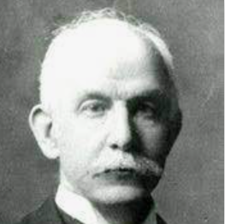
INEQUALITY AND REDISTRIBUTION
The Lorenz Curve
Developed by economist Max Lorenz.
Graph income equality/inequality by plotting the:
cumulative fraction of the population [x-axis], and;
cumulative fraction of total income [y-axis]—ordered from lowest to highest.
In short, the Lorenz Curve graphically compares the level of income inequality across different countries.
KENNESAW STATE UNIVERSITY | COLES COLLEGE OF BUSINESS
Notes:
Developed by economist Max Lorenz, the Lorenz Curve provides a way to graphically compare levels of income inequality across different countries.

Slide 12
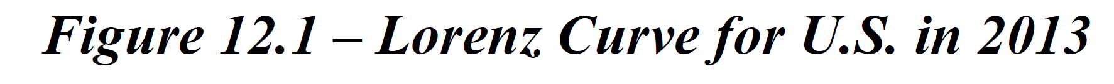
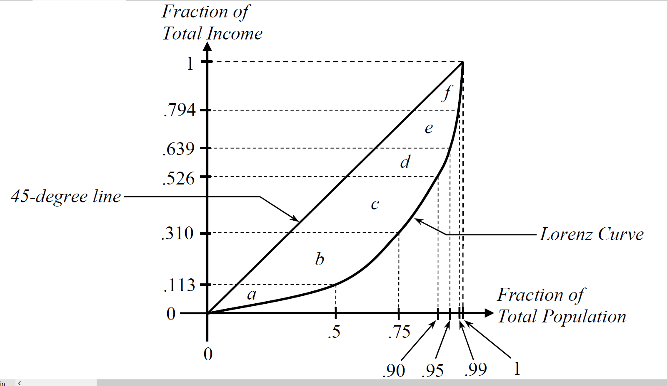
INEQUALITY AND REDISTRIBUTION
Distribution of Income in the U.S. in 2015
Segment of the Population (X-axis) | Bottom 50% | Bottom 75% | Bottom 90% | Bottom 95% | Bottom 99%
Cumulative Share of Income (Y-axis) | 11.3% | 31.0% | 52.6% | 63.9% | 79.4%
Income Cutoff | $39,275 | $79,655 | $138,031 | $195,778 | $480,930
KENNESAW STATE UNIVERSITY | COLES COLLEGE OF BUSINESS
Notes:
See pg. 287 in the textbook.

Slide 13
INEQUALITY AND REDISTRIBUTION
CALCULATING
GINI
COEFFICIENTS
Red Area
G =
Blue Area + Red Area
KENNESAW STATE UNIVERSITY | COLES COLLEGE OF BUSINESS
Notes:
A Gini Coefficient = 0 indicates a society that has zero income inequality (everyone earns the same income).
A Gini Coefficient = 1 indicates a society where income is perfectly unequal (one person earns 100% of the income).

Slide 14
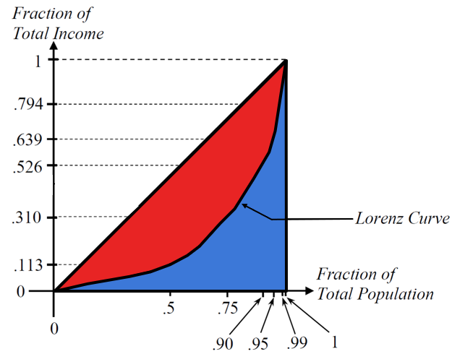
INEQUALITY AND REDISTRIBUTION
Gini Coefficient
Numerical measure of income inequality (between 0 and 1):
Ratio of the lens shaped area of the Lorenz Curve and the 45-degree line, to the total area below the 45-degree line.
Gini Coefficient = 0 indicates a society that has zero income inequality (everyone earns the same income). Gini Coefficient = 1 indicates a society where income is perfectly unequal (one person earns 100% of income).
KENNESAW STATE UNIVERSITY | COLES COLLEGE OF BUSINESS

Slide 15
INEQUALITY AND REDISTRIBUTION
FYI
A GINI COEFFICIENT DOES NOT MEASURE QUALITY OF LIFE (QOL).
IT MEASURES INCOME INEQUALITY
KENNESAW STATE UNIVERSITY | COLES COLLEGE OF BUSINESS

Slide 16
INEQUALITY AND REDISTRIBUTION
Gini Coefficient & Average Income in U.S.
Year | 1967 | 1976 | 1986 | 1996 | 2006 | 2016
Gini Coefficient | .397 | .398 | .425 | .455 | .470 | .481
Median Household Income | $44,895 | $48,673 | $52,068 | $54,105 | $57,379 | $59,039
Mean Household Income | $50,213 | $57,252 | $64,328 | $71,836 | $79,246 | $86,143
Note: Gini coefficient becomes closer to 1 as it rises between ‘67–‘16, thereby indicating that society’s income is becoming more and more unequal.
KENNESAW STATE UNIVERSITY | COLES COLLEGE OF BUSINESS
Notes:
The table above uses “Real 2016 dollars” across all years.
See pg. 289.

Slide 17
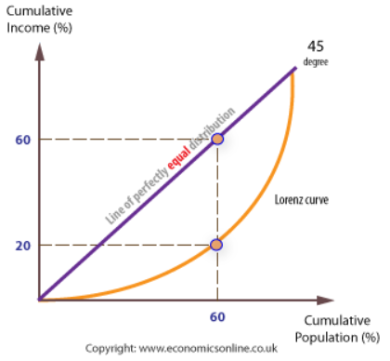
INEQUALITY AND REDISTRIBUTION
Perfect equality would be where 60% of the population gain 60% of national income.
In this situation 60% of the population gain only 20% of the income, so the Lorenz Curve falls short of the line of perfectly equal distribution of income.
The further the Lorenz curve is from the 45° line, the less equal is the distribution of income.
KENNESAW STATE UNIVERSITY | COLES COLLEGE OF BUSINESS

Slide 18
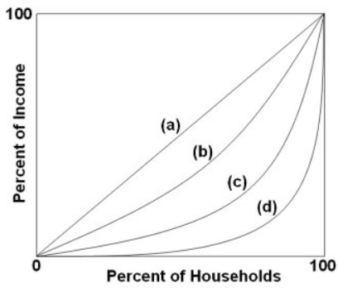
INEQUALITY AND REDISTRIBUTION
Refer to the graph. If the Lorenz curve shifted from (d) to (b), then the Gini ratio and the degree of income inequality would:
Increase
Decrease
Remain the same.
All of the above
Answer: B
KENNESAW STATE UNIVERSITY | COLES COLLEGE OF BUSINESS

Slide 19
INEQUALITY AND REDISTRIBUTION
Suppose that the Lorenz Curve for the U.S. in 2018 lies completely below the Lorenz Curve for Sweden in 2018. This implies that:
A. Incomes are higher in the U.S.
B. Incomes are higher in Sweden
C. Incomes are more equal in Sweden
D. Incomes are more equal in the U.S.
Notes:
Answer: C

Slide 20
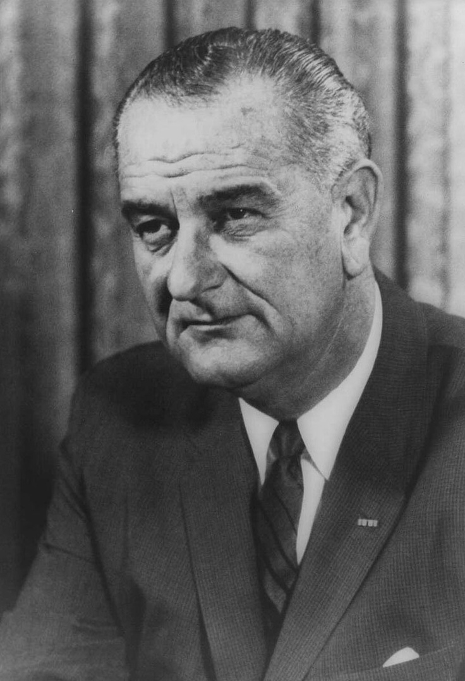
INEQUALITY AND REDISTRIBUTION
In 1964, President Lyndon B. Johnson declared a “War on Poverty” in America
Economic Opportunity Act of 1964
Food Stamp Act of 1964
Elementary & Secondary Education Act
Social Security Act of 1965
But…
How did this war on poverty panned out?
First, let us define poverty and describe how it is measured in the United States.
KENNESAW STATE UNIVERSITY | COLES COLLEGE OF BUSINESS
Notes:
How is this a war on poverty? Let us first define poverty and describe how it is measured in the United States.

Slide 21
INEQUALITY AND REDISTRIBUTION
POVERTY
Very “limited access” to G&S.
Federal govt defines poverty based on family size & income.
POVERTY THRESHOLDS
If a family’s total income is less than the poverty threshold set by the federal government, then that family is considered impoverished.
The official poverty measure is adjusted annually to account for inflation.
The thresholds are established by the U.S. Census Bureau.
U.S. poverty thresholds are based on family size and the ages of individuals in the household.
It is important to note that poverty is a relative concept. Poverty in the U.S. is very different from poverty in Nepal.
KENNESAW STATE UNIVERSITY | COLES COLLEGE OF BUSINESS

Slide 22
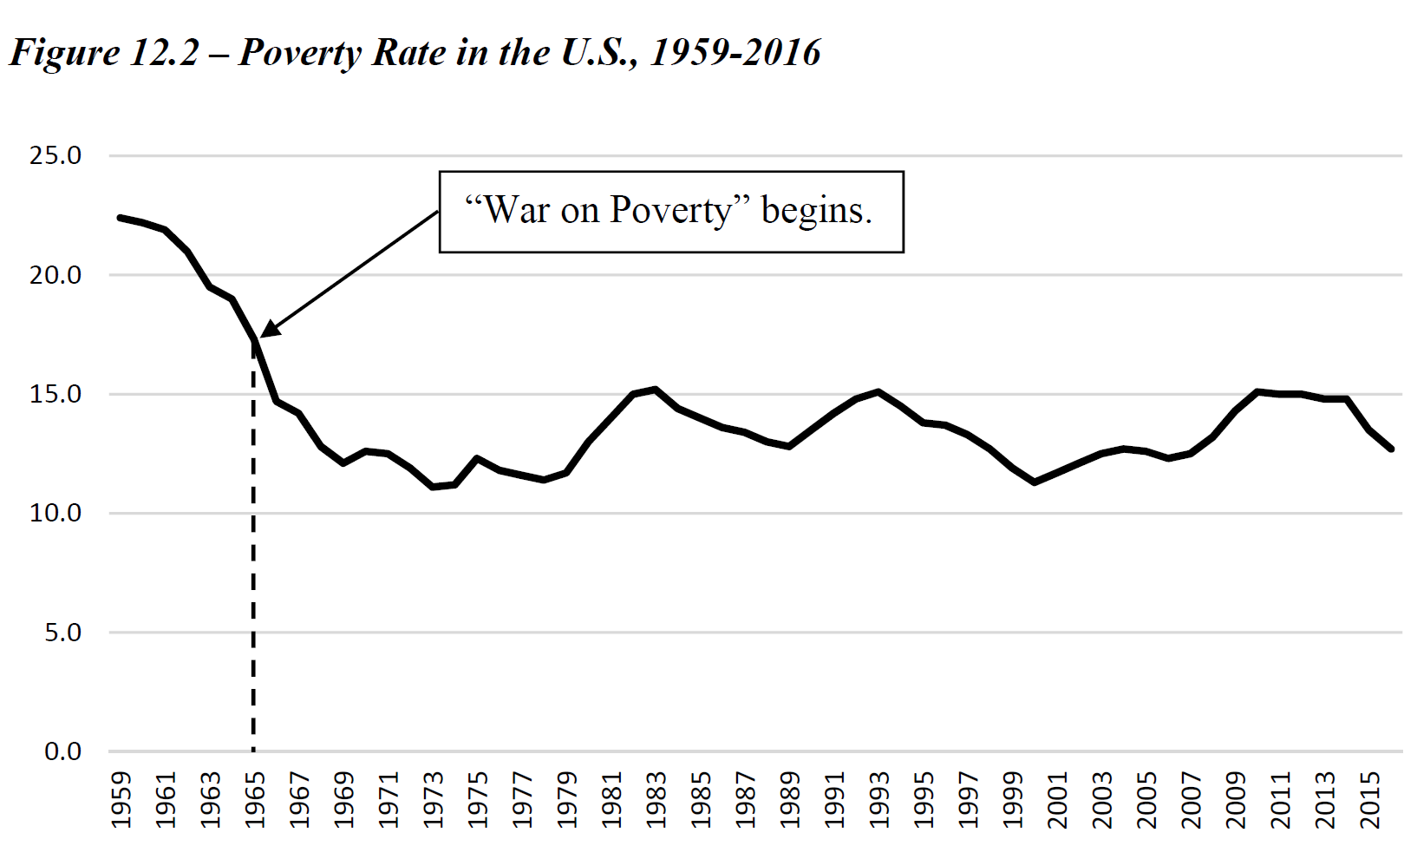
INEQUALITY AND REDISTRIBUTION
THE POVERTY RATE
FYI
Official poverty rate in 2021 was 11.6%, with 37.9 million people in poverty.
Percentage of the population living below the poverty threshold.
Notes:
Is Johnson’s “war on poverty” responsible for the sharp decline?

Slide 23
INEQUALITY AND REDISTRIBUTION
IS JOHNSON’S “WAR ON POVERTY” RESPONSIBLE FOR THE SHARP DECLINE?”
Yes, but only partially because poverty was ‘already’ on a downward trend prior to Johnson’s policies.
Key are technology and the benefits of economic growth
KENNESAW STATE UNIVERSITY | COLES COLLEGE OF BUSINESS
Notes:
The answer is: If so, only partially. The matter is complicated. Poverty was already on a downward trend prior to Johnson’s policies. In addition, there are other relevant factors to discuss such as technology and the benefits of general economic growth…

Slide 24
INEQUALITY AND REDISTRIBUTION
Technology & Economic Growth has made the gap between rich & poor far less extreme today than 200 years ago
“Most Americans who are considered ‘poor’ today have routine access to a quality of housing, food, healthcare, consumer products, entertainment, communications, and transportation that even the Vanderbilt's, the Carnegies, the Rockefellers, and the 19th century European princes, with all their wealth, could not have afforded.”
S. Moore, J. Simon
KENNESAW STATE UNIVERSITY | COLES COLLEGE OF BUSINESS
Notes:
Let’s begin by discussing the nature of technology and economic growth. The distance in “quality of life” between the rich and the poor is far less extreme today than it was 200 years ago.
*Quote from “It’s Getting Better All the Time: 100 Greatest Trends of the Last 100 Years” by Stephen Moore and Julian Simon (CATO Institute, Washington, D.C., pg. 6),

Slide 25
Amenities of “ALL” Households in 1950 vs. Poor Households in 1997
Household Amenity | Ownership Rate for “All” Households Below Poverty Line in 1950 | Ownership Rate for Households Below Poverty Line in 1997
Electricity | 94% | 99%
Flush Toilet | 76% | 99%
Refrigerator | 80% | 99%
Television | 10% | 95%
Telephone | 79% (1960) | 88%
Automobile | 59% | 71%
Air Conditioning | 12% (1960) | 70%
Clothes Dryer | 2% | 48%
Dishwasher | 2% | 28%
NOTE: Because of Technology & Economic growth, Americans living in “Poor Households” in 1997 have more routine access to amenities than “All Households” in 1950.
Notes:
See pg. 293

Slide 26
INEQUALITY AND REDISTRIBUTION
REDISTRIBUTION
Policies designed to alter the levels of consumption or income of households within a society (usually from rich to poor).
Redistribution in-kind
Transfer of G&S (Medicaid, WIC, SNAP)
Income support
Transfer of money—earned income tax credit [EITC], & Temporary Assistance for Needy Families (TANF).
Universal Basic Income
Provide everyone in society with a lump-sum payment in regular intervals, regardless of their income, resources or employment status (e.g., Finland)
KENNESAW STATE UNIVERSITY | COLES COLLEGE OF BUSINESS

Slide 27
INEQUALITY AND REDISTRIBUTION
Redistribution Spending in the U.S. (2012)
U.S. government spending on welfare programs…
Roughly $952 billion; About 6% of GDP
About $20,610 per poor person in the country
Expensive: partly due to complex bureaucracy.
takes about $7 of taxes to get $1 of additional income into the hands of a recipient
KENNESAW STATE UNIVERSITY | COLES COLLEGE OF BUSINESS
Notes:
Redistribution is expensive and inefficient. And some individuals heavily depend upon the government to support their lives. Given that this is an economics course, it seems fair to ask: “Are the marginal social benefits of redistribution equal to or greater than the marginal social costs of redistribution?”

Slide 28
INEQUALITY AND REDISTRIBUTION
ARGUMENTS
“FOR” & “AGAINST ”
COERCIVE REDISTRIBUTION
KENNESAW STATE UNIVERSITY | COLES COLLEGE OF BUSINESS
Notes:
Let’s look at the arguments for and against coercive redistribution of income in society.

Slide 29
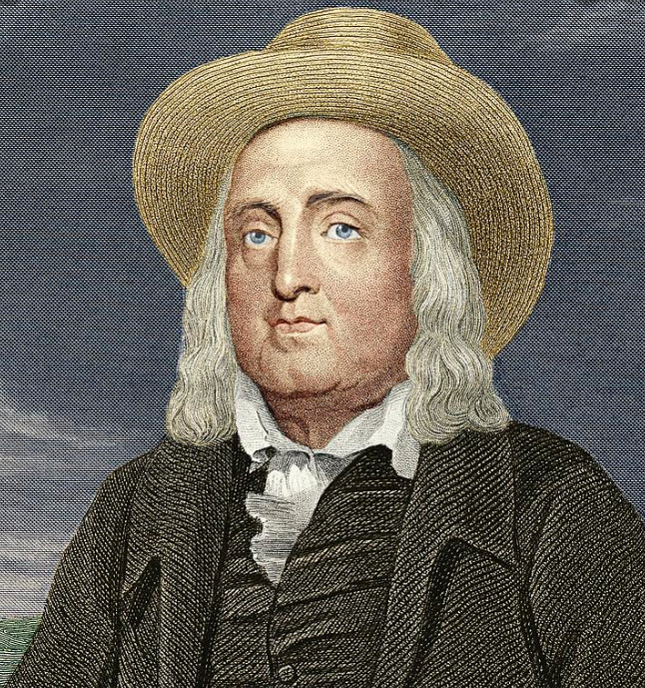
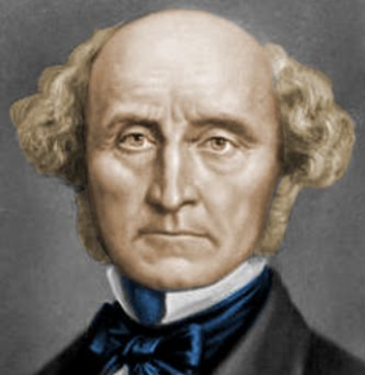
INEQUALITY AND REDISTRIBUTION
1. Utilitarian Justice
Morally Best Outcome: maximize sum of happiness; (minimize suffering)
Jeremy Bentham
John Stuart Mill
Utilitarian Arguments Favored …
Redistribution
Total Social Welfare can be increased by transferring income/wealth from the rich to the poor, so long as,
People have a diminishing marginal utility* for money. *Suggests that rich people derive less benefit from extra money than do poor people
KENNESAW STATE UNIVERSITY | COLES COLLEGE OF BUSINESS

Slide 30
INEQUALITY AND REDISTRIBUTION
____________ were two of the central figures in the formulation of the ideas of Utilitarian Justice?
A. Karl Marx and Friedrich Engels
B. Jeremy Bentham and John Stuart Mill
C. Max Lorenz and Corrado Gini
D. John Harsanyi and Robert Frank
KENNESAW STATE UNIVERSITY | COLES COLLEGE OF BUSINESS
Notes:
Answer: B

Slide 31
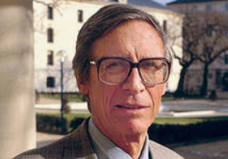
INEQUALITY AND REDISTRIBUTION
2. Rawlsian Justice
The Maximin Criterion:
Redistribution:
Argument claiming that institutions must be structured to benefit the least well-off person in society.
John Rawls improved on social contract theory
“Social contract" designed behind a “veil of ignorance*” would aim to “maximize the well-being of the worst-off member of society.”
*Veil of ignorance: Behind this veil, one knows nothing about another’s natural abilities, position in society, sex, race, nationality, or individual tastes.
KENNESAW STATE UNIVERSITY | COLES COLLEGE OF BUSINESS

Slide 32
INEQUALITY AND REDISTRIBUTION
_________________ wrote A Theory of Justice (1971), where he argued that a “social contract” designed behind a “veil of ignorance” would aim to “maximize the well-being of the worst-off member of society.”
Karl Marx
Max Lorenz
John Rawls
Robert Nozick
KENNESAW STATE UNIVERSITY | COLES COLLEGE OF BUSINESS

Slide 33
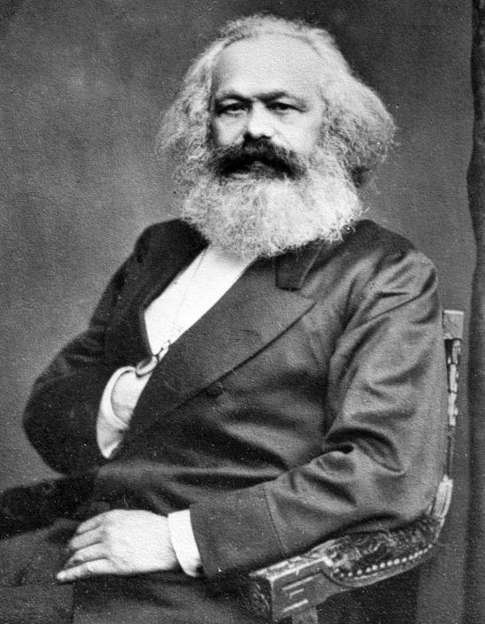
INEQUALITY AND REDISTRIBUTION
3. Labor Theory of Value
“Value of a product should be measured by the amount of labor used to produce the good, rather than allowing the market to place a value on the good.”
Karl Marx
Advocated for the complete abandonment of the property rights system of free market capitalism
In Marx’s eyes, landowners and factory owners were able to sit back and extract part of the value created by the efforts of labor.
KENNESAW STATE UNIVERSITY | COLES COLLEGE OF BUSINESS

Slide 34
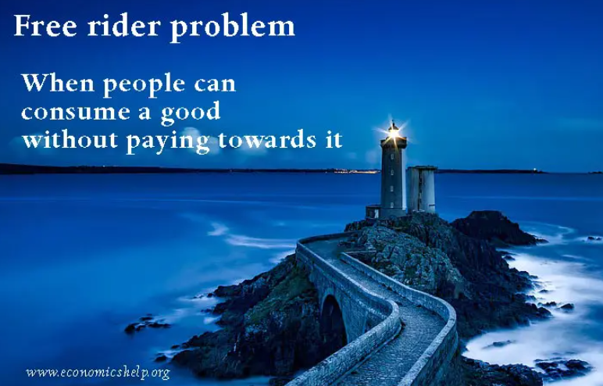
INEQUALITY AND REDISTRIBUTION
4. Overcoming the Free-Rider Problem
(poverty-reduction is non-excludable/non-rival for everyone, so the free-rider problem arises)
Argument that poverty-reduction is:
a public good, so;
Gov. is needed to undo the “free-rider” situation of underproduction.
Gov. accomplishes this by spreading out the costs through taxes.
KENNESAW STATE UNIVERSITY | COLES COLLEGE OF BUSINESS

Slide 35
INEQUALITY AND REDISTRIBUTION
5. Disincentive Effects of Redistribution
Argues that redistribution policies disincentivize individuals from working or investing in their human capital.
Poverty Trap (Unintended consequence): Person’s efforts to escape poverty is discouraged due to perverse incentives (e.g., recipients of welfare are discouraged to work).
To lessen the chance of creating Poverty Traps —
Means Tested Programs: Require that an individual have a low income to be eligible to receive benefits.
KENNESAW STATE UNIVERSITY | COLES COLLEGE OF BUSINESS

Slide 36
INEQUALITY AND REDISTRIBUTION
To be eligible to receive a means tested benefit, a recipient must:
A. show evidence of seeking employment and not using drugs
B. be over a certain age
C. agree with the Rawlsian Justice argument.
D. have income below a certain level.
KENNESAW STATE UNIVERSITY | COLES COLLEGE OF BUSINESS
Notes:
Answer: D

Slide 37
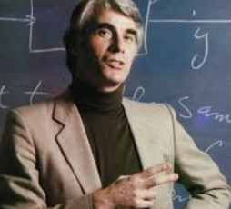
INEQUALITY AND REDISTRIBUTION
Equality of opportunity is driven by the idea of treating individuals fairly and equally.
6. Libertarian Justice
Argument that prioritizes “equality of opportunities” over “equality of outcomes” by preserving free markets and “negative rights.”
Robert Nozick
Equality of Opportunity is driven by the idea of treating individuals fairly & equally.
Libertarians favor small government, free markets, “negative rights” (e.g., permit inaction), & generally opposed to redistribution.
KENNESAW STATE UNIVERSITY | COLES COLLEGE OF BUSINESS

Slide 38
Some slides generated by Daniel Forsberg
INEQUALITY AND REDISTRIBUTION
Notes:
End of slides.

